Slide 1
Antibody-Target Binding Paper Outline

Slide 2
Objectives and Conclusions
Side objective: Are there any differences between the modelling methodologies for second binding event?
The methodologies predict the same outcomes for the analysis shown
1: What are they key parameters affecting antibody-target binding dynamics, receptor occupancy and bound antibody number?
1: The ratio of antibody to receptor is important; it affects binding dynamics and steady state binding states and sensitivities. There are different sensitivities for RO and bound ab with rtot being important.
2: What conditions are optimal for an antibody to gain an avidity effect?
2: There are optimum KDs and rtots for the avidity effect. These optimums changes whether you are seeking an avidity effect for RO or bound ab.

Slide 3
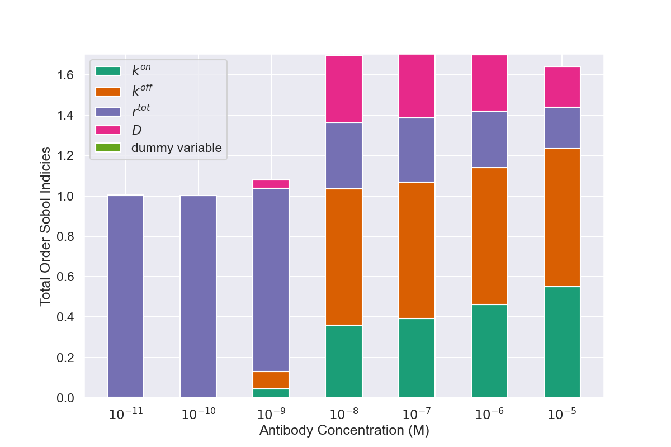
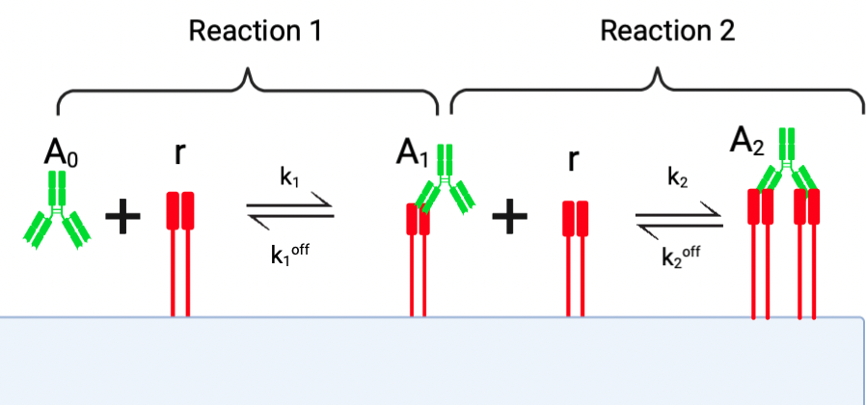
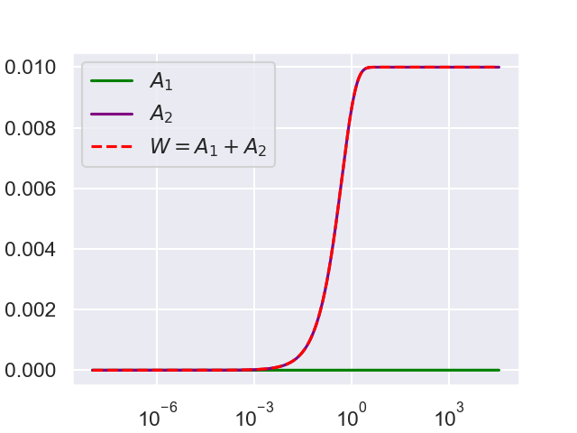
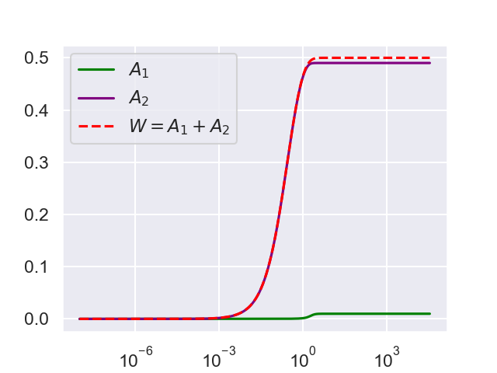
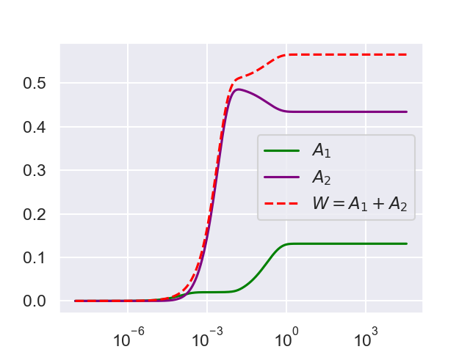
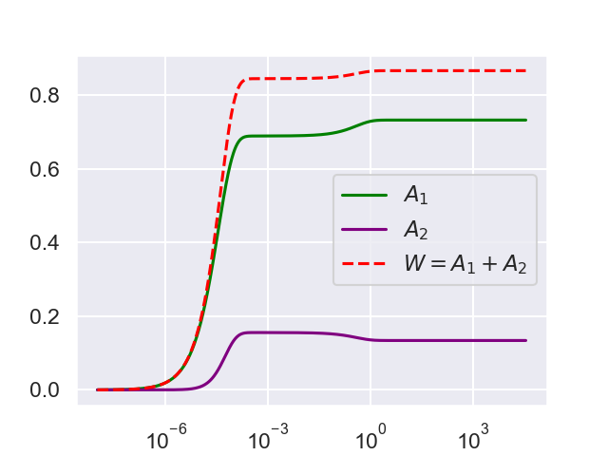
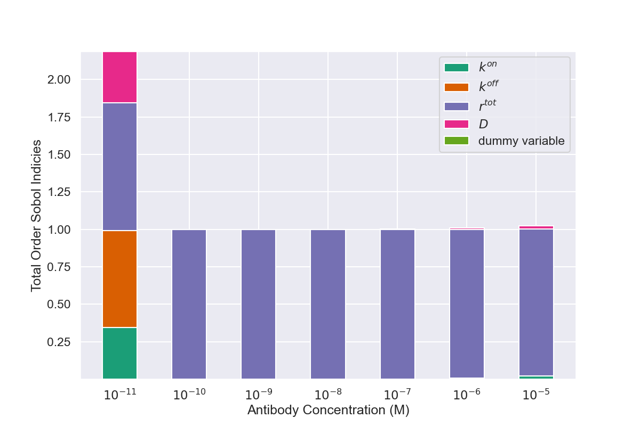
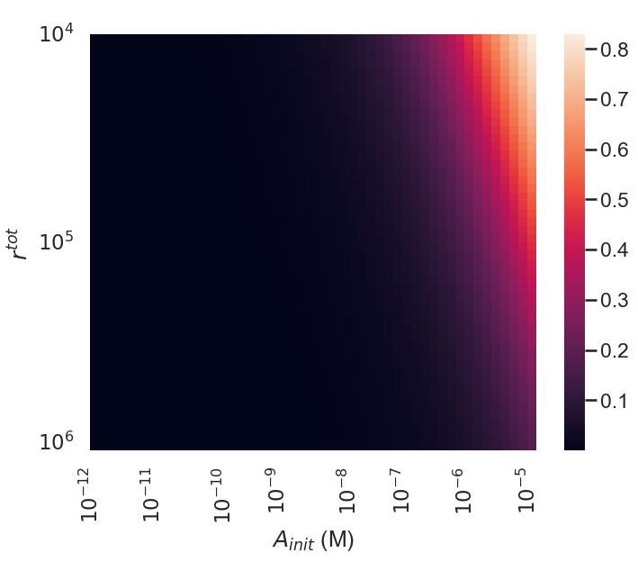
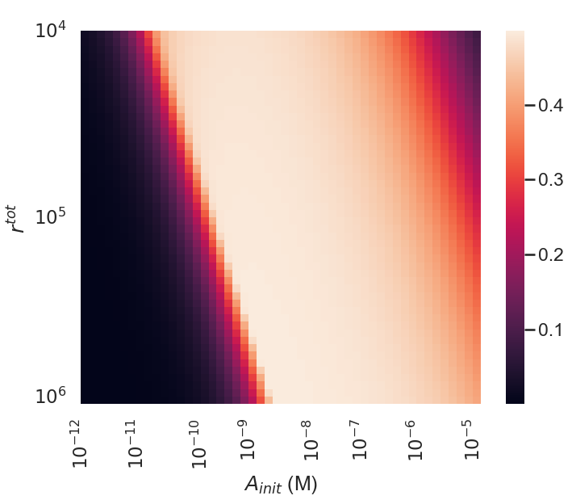
Objective 1 Figures

Slide 4
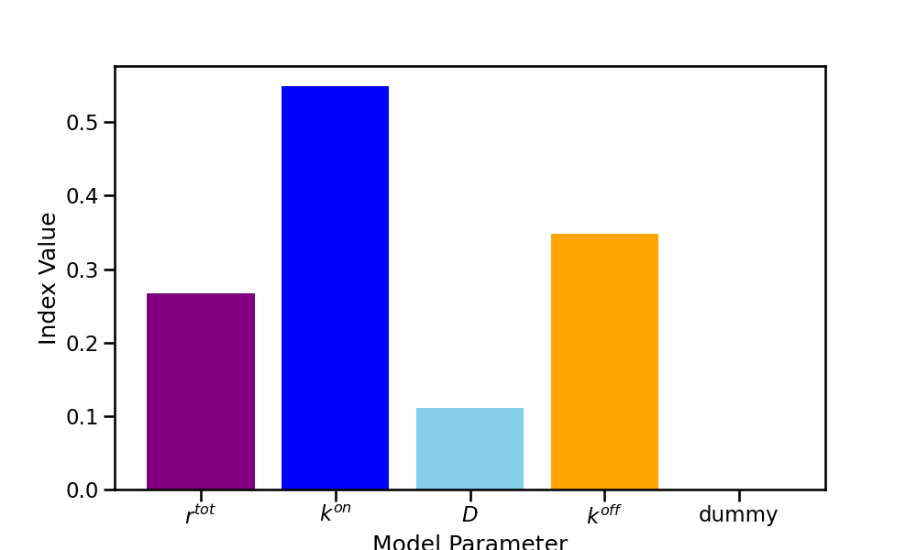
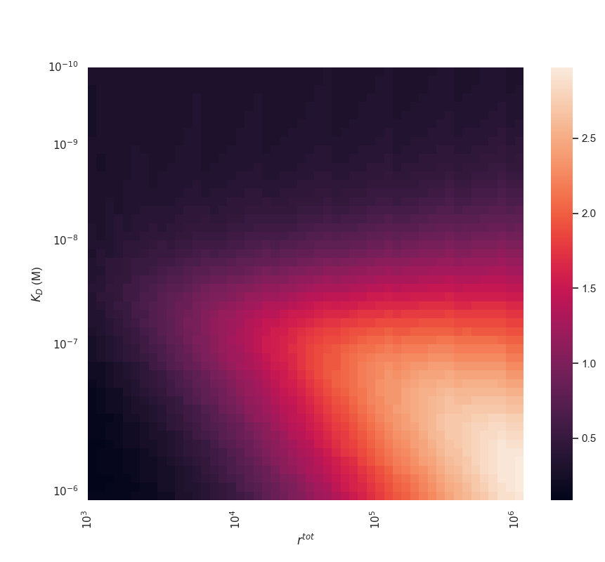
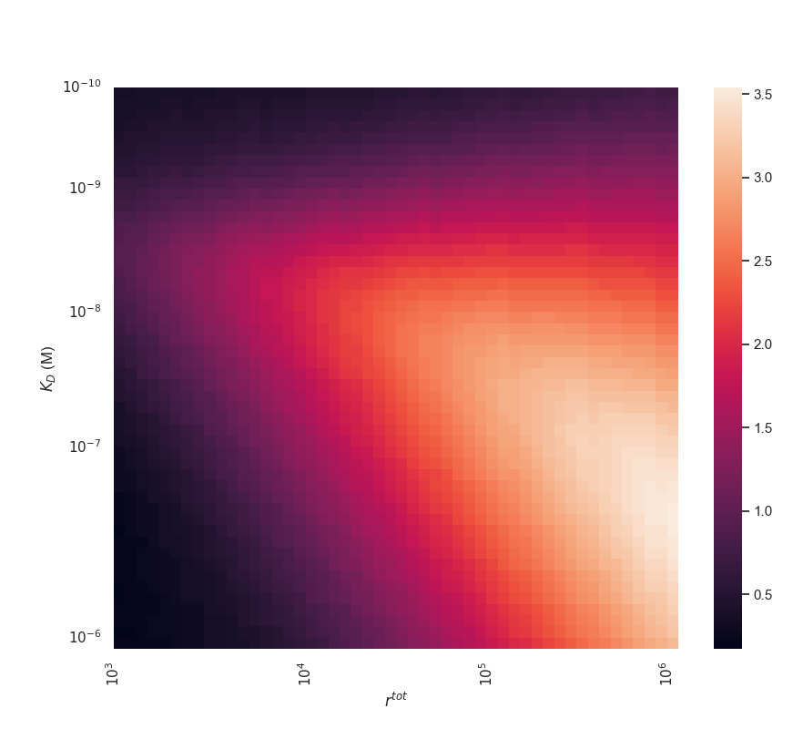
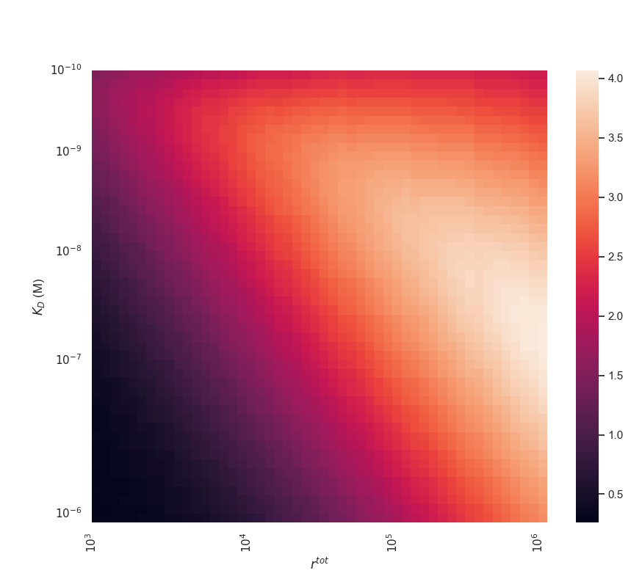
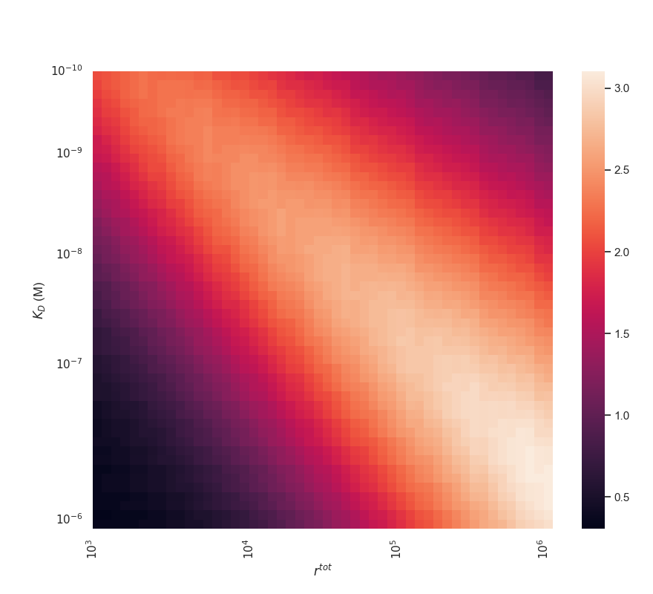
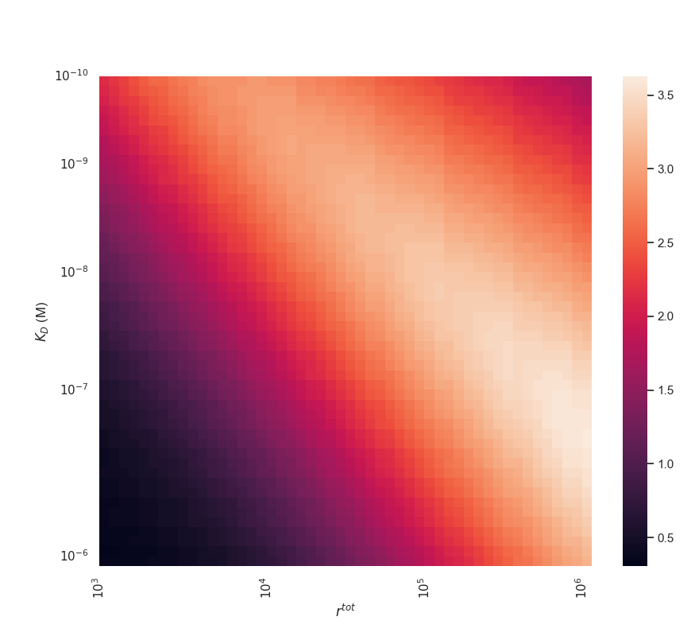
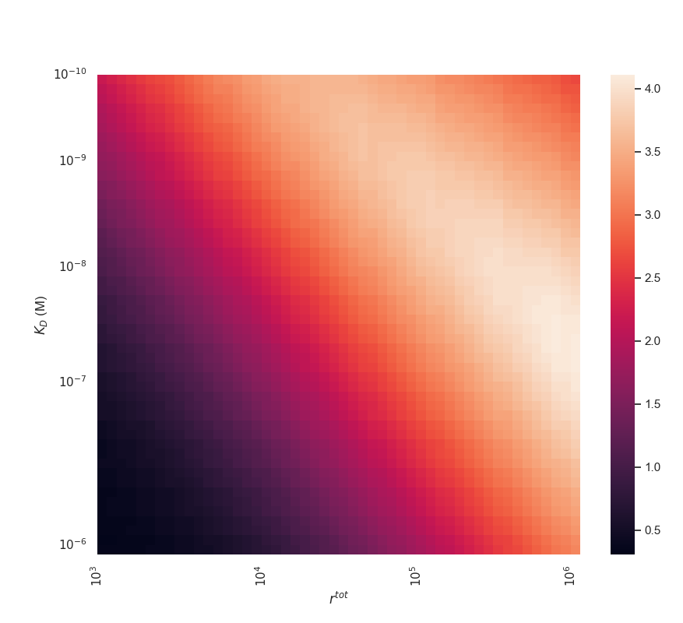
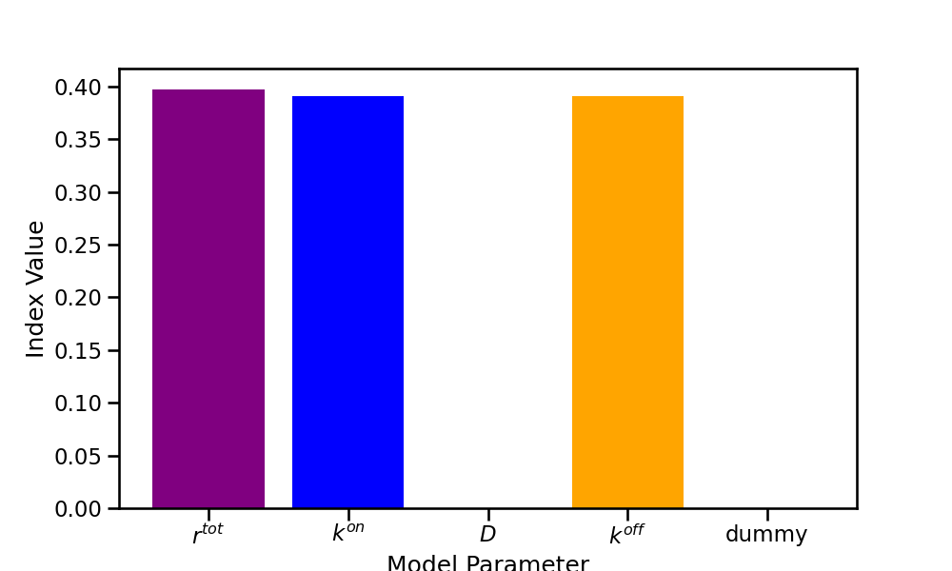
Objective 2 Figures

Slide 6
Structure
Intro
Importance of mAbs
Effect of microscale on efficacy (Mazor papers)
Mathematical Model
Same as transfer
Results
Equilibrium binding states
rtot and bound ab sensitivity analysis
Discussion
Appendix
Why we care about avidity
Previous modelling studies
Further details of model and parameters?
Additional asymptotic cases
Identifiability analysis?
Dynamics + asymptotics case
Avidity investigation
Discuss objectives and conclusions
Relevance to therapies and avidity experiments
Future work: Include receptor internalization and link with experiments?

